Slide 1
A code based intro to CUDA and OpenMP
And an overview of other parallel computing technologies.

Slide 2
Why the interest
Why are we interested in parallel computing using CPUs and GPUs?
  Because they have multiple cores which means they have multiple execution units.

Slide 3
The problem.
Multi core CPU and GPU can be used to exploit two types parallelism in code:
  Task parallelism
  Data parallelism

Slide 4
Task parallelism has been exploited even without multi core CPUs.
  Think long running operations initiated through UI initiated on a separate thread to ensure the UI remains responsive.
  Illusion of concurrent execution on single core CPUs but on multi-core CPUs it is no longer an illusion.

Slide 5
Exploiting data parallelism has been made possible with advent of multiple cores on CPUs and GPUs
  for(int i=0;i<2;i++)
  {
  c[i] = a[i] + b[i];
  // a[i] = a[i-1] + 10;
  }
  Statement remains same but the data is changing for every iteration.
  Only those loops are parallelizable in which each iteration is independent.

Slide 6
Benefit without much work.
Use OpenMP to parallelize the loop:
  #pragma omp parallel for
  for(i=0;i<N;i++)
  {
  a[i]= a[i]+10;
  }

Slide 7
Data sharing attribute clauses
  shared: the data within a parallel region is shared, which means visible and accessible by all threads simultaneously. By default, all variables in the work sharing region are
  shared except the loop iteration counter.
  private: the data within a parallel region is private to each thread, which means each
  thread will have a local copy and use it as a temporary variable. A private variable is
  not initialized and the value is not maintained for use outside the parallel region. By
  default, the loop iteration counters in the OpenMP loop constructs are private.
  default: allows the programmer to state that the default data scoping
  within a parallel region will be either shared, or none for C/C++.
  Equivalent loop:
  #pragma omp parallel for default(none) shared(a,N) private(i)
  for(i=0;i<N;i++)
  {
  a[i]= a[i]+10;
  }

Slide 8
Synchronization Clauses
OpenMP provides synchronization clauses to deal with thread synchronization
  Race conditions: think of statements like the following being executed by multiple threads
    a = a +10; (variable a points to a shared memory location. It is not private to a thread as variable declaration is outside the loop)
  There was no need to use synchronization in the code I have written.
  Implicit join after the OpenMP loop.

Slide 9
Tips
Parallelize a significant chunk of work. That means, for a nested loop, parallelize the outer loop.
Parallelizing a single (not nested) loop might even decrease performance. Cost of starting a new CPU thread is high and should be kept busy for a significant amount of time.
For a CPU with n cores, where n>2, the best performance will be at n-1 threads.

Slide 10
Ponder over.
int syncRequired = 2;
int syncNotRequired = 3;
int d,f;
#pragma omp parallel for
for(int i=0;i<10;i++)
{
int noSync1 = 10 +i ;
int noSync2 = a[i]+b[i];
syncRequired = syncRequired+i;
syncNotRequired = d + f;
c[i]=a[i]+b[i];//no sync required
}
Notes:
int noSync = 10 +i ;//we are defining a different variable(although same name) for every iteration(let alone thread)..no issues here int noSync = a[i]+b[i];//we are defining a different variable(although same name) for every iteration(let alone thread)..no issues here. //note that variable i would be private to each thread (in OpenMP) syncRequired = syncRequired+i;//not an atomic operation...sync required as variable across different threads is same. value would //be read from memory to register to do addition. but after addition, suppose iterrupted by another thread. So the result is still //in register and not written back to memory. the other thread would read the old value from memory and do the addition in register. //So got the race condition due to non-atomic opertaions. Note that syncRequired is a shared variable accross threads syncNotRequired = d+ f;//if though it syncNotRequired is a shared variable(and so are d and f), but since d and f are not being //changed between iterations, no sync is required c[i]=a[i]+b[i];// note that even though c is a shared array(and so are a and b), the changes occuring in them use the iteration variable i //and since it is private to different threads(OpenMP), even if a thread is interupted, we don't have a race condition. since each i would //be different, the underlying array data from the memory being loaded into registers for processing is different. So no race conditons //even if one thread interupts another, the value of i would be different and hence memory locations being referred

Slide 11
CUDA
C extensions.
Run code on your multi core GPU.
Multi core GPUs have existed for a long time but the underlying hardware was not exposed for numerical computation.
Earlier you had to code against graphics APIs like opengl or direct 3d.

Slide 12
How is latency handled
CPU uses cache. Localized data would be read into cache for each memory access. So costly RAM memory reads are avoided.
  - for(i=0;i<100;i++)
  {
  c[i] = a[i]+10;
  }
Consecutive memory operations should fit into loop stride length to take advantage of cache.
GPU avoids latency as it has high memory bandwidth.
Notes:
stride length

Slide 13
Supports hybrid Code
Mix host (CPU) code with device code (GPU)
Data parallel portions are device kernels. You can’t parallelize your loop “as it is” that is possible with OpenMP.
Each kernel is run on a grid of thread blocks where each thread block is a 3 dimensional collection of threads
But no implicit fallback over to CPU.

Slide 14
  for(int i=0;i<N;i++)
  {
  c[i] = a[i] + b[i];
  }
  Equivalent kernel is:
  __global__ void VecAdd(int *Nptr, double *A, double *B, double *C )
  {
  int N = *Nptr;
  int i = blockDim.x * blockIdx.x + threadIdx.x;
  if(i<N)
  {
  C[i]= A[i]+B[i];
  }
  }
Notes:
Using the dimensions of a thread as an index into the array is a bit mind bending.
the intent of the formula is to get the indices into the array correct.....for N=3 u would like to have nx(0 to 2) and ny(0 to 2)...think of the loop in serial code and do some trial runs to produce the same indices....there are other ways to compute that...examples in SDK but essentially, i think, we have to get the index correct.
If N=17, then we need 2 of [16,16] thread blocks. imagine the both(inner and outer) loop running for 0 to 15 times.
For example [16,16] threadblock…..every thread in it would have 2-dims. so [0,0] is one thread[0,1] is another thread…threadix.x and threadidx.y give u the x or y dimension values for the calling thread.
Now that dimensional value is local to a threadblock…to calculate a global value we do blockDim.x + blockIdx.x + threadIdx.x; …
Now the dimensions of a thread are used as an index into the array. clever!!

Slide 15
Kernel invocation
int *dev_N =0;
double *dev_A = 0;
double *dev_B = 0;
Double *dev_C = 0;
cudaMalloc((void**)&dev_N, sizeof(int));
cudaMalloc((void**)&dev_A, N * sizeof(double) );
cudaMalloc((void**)&dev_B, N * sizeof(double));
cudaMalloc((void**)&dev_C, N * sizeof(double) );
cudaMemcpy(dev_N, &N, sizeof(int), cudaMemcpyHostToDevice);
cudaMemcpy(dev_A, A, N * sizeof(double), cudaMemcpyHostToDevice);
cudaMemcpy(dev_B, B, N * sizeof(double), cudaMemcpyHostToDevice);
dim3 threadsPerBlock =10;
dim3 blocksPerGrid = (ceil((double)N/10));
VecAdd<<<blocksPerGrid,threadsPerBlock>>>(d_A,d_B,d_C);
cudaMemcpy(C, dev_C, sizeof(double), cudaMemcpyDeviceToHost);

Slide 16
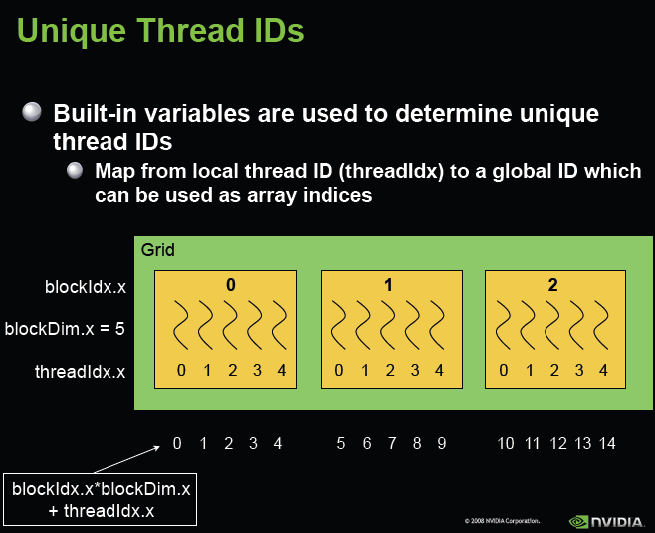

Slide 17
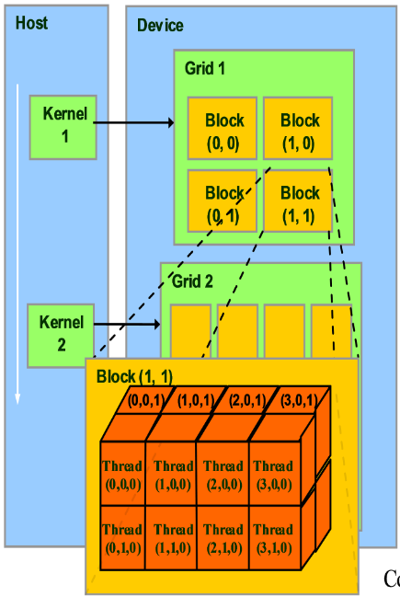

Slide 18
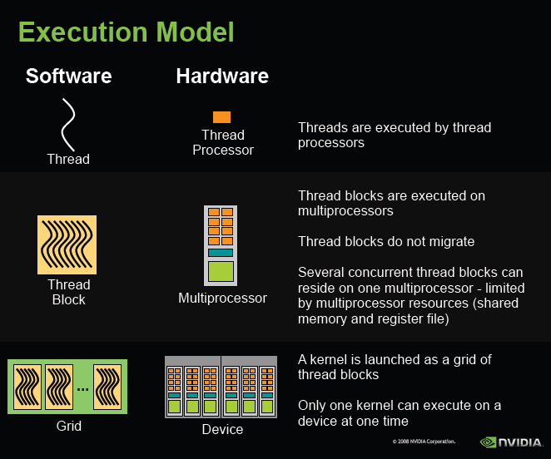

Slide 19
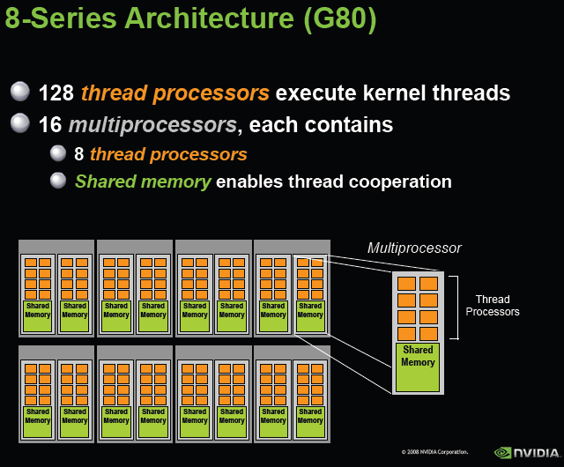

Slide 20
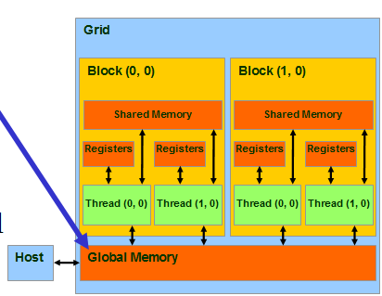
CUDA Memory Model Overview

Slide 21
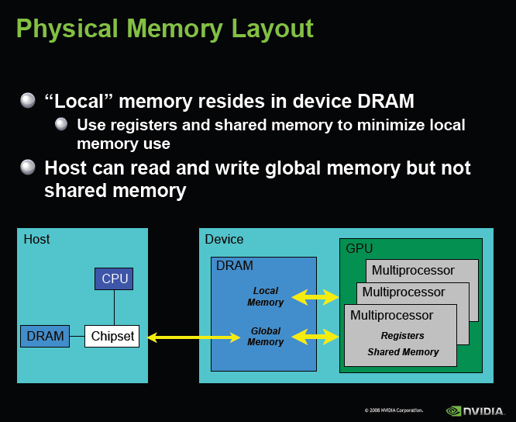

Slide 22
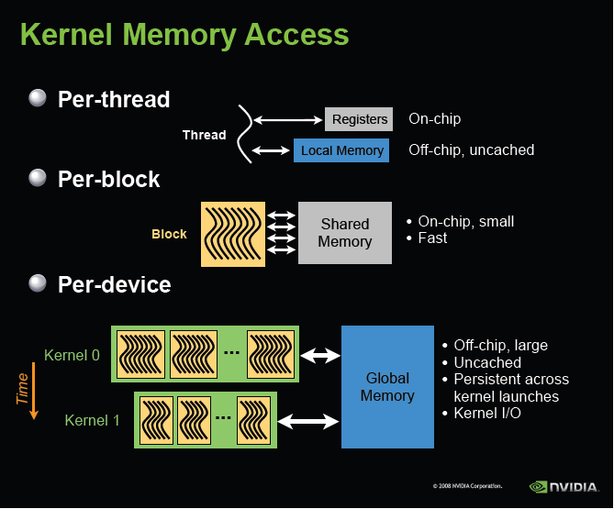

Slide 23
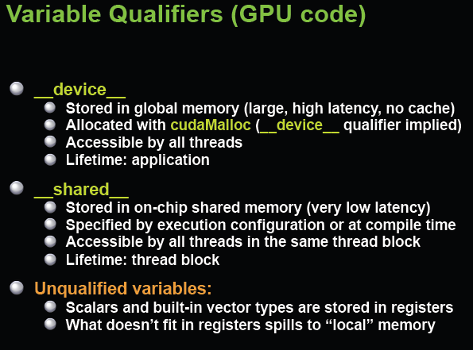

Slide 24
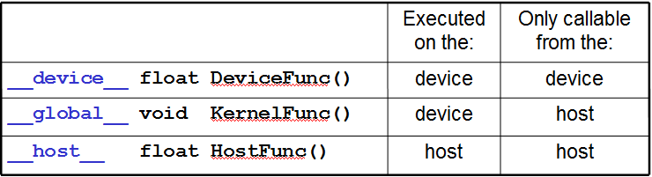
CUDA Function Declarations
•__device__ and __host__ can be used together
•For functions executed on the device:
–No recursion
–No static variable declarations inside the function
–No variable number of arguments

Slide 25
Synchronization
Kernel launches are asynchronous.
To synchronize, use cudaMemcpy or cudaThreadSynchronize

Slide 26
Issues faced
Compute capability on my laptop was less than 1.3. So got wrong GPU results as compared to CPU results.
Had to do a bit of work to get the indexes into the arrays correct.
walltime vs cputime.
On my GPU, the thread block could have up to 1024 threads (i.e [32,32]). But limit reached at [25,25].
By default, the compute capability is still specified at 1 in CUDA projects. So double precision won’t work.
Release mode results different from debug mode results. Had to use –fmad=false to get correct results.
Could not execute CUDA over remote desktop connection.
NVIDIA forums down this month. So could not get much support.

Slide 27
Precision
Earlier GPUs did not follow IEEE floating point standard and had single precision capability only.
I think the flop figures quoted are for single precision operations. Example:GT200 chip delivers almost 1 teraflop (1,000 gigaflops) of single precision and almost 100 gigaflops of double precision performance.

Slide 28
Parallel compute land
Parallel Patterns Library (PPL) for CPU parallelism and AMP for GPU parallelism on windows platform. Although AMP is open specification but at the moment support for windows only. AMP code can fallback on CPU cores.
OpenACC is OpenMP equivalent for GPGPU. Uses pragma directives.
OpenMP and PPL targets CPU parallelism cores. AMP, OpenCL, DirectCompute, OpenACC and CUDA target GPU cores.
OpenMPI is used for message passing parallelism (cluster computing).
OpenMP and OpenCL supported by different compilers on different platforms.

Slide 29
References
https://www.coursera.org/#course/hetero
http://courses.engr.illinois.edu/ece498/al/Syllabus.html
http://sbel.wisc.edu/Courses/ME964/2008/Documents/nvccCompilerInfo.pdf
http://webcache.googleusercontent.com/search?q=cache:p8jrF5P-gnkJ:forums.nvidia.com/index.php%3Fshowtopic%3D106028+&cd=4&hl=en&ct=clnk&gl=au
http://stackoverflow.com/questions/9421108/g-nvcc-how-to-compile-cuda-code-then-link-it-to-a-g-c-project
http://developer.download.nvidia.com/assets/cuda/files/NVIDIA-CUDA-Floating-Point.pdf
http://www.nvidia.com/content/cudazone/download/Getting_Started_w_CUDA_Training_NVISION08.pdf
http://mersenneforum.org/showthread.php?p=263717
http://parlab.eecs.berkeley.edu/wiki/_media/patterns/loop_parallelism.pdf

